Slide 1
Bee Lazi
APCS_01

Slide 2



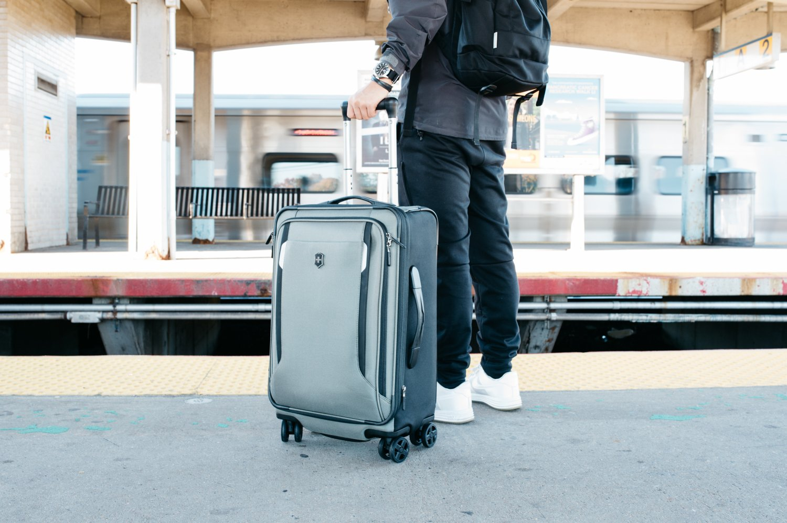
Problem Statement

Slide 3

Product Position Statement
Feel the need of oriented suggestions.
A mobile application on Android platform.
Creates an innovation of smart interaction between smart suggestion application and user’s personality.
Other products | Our product
which suggest specific field optimistically based on their data without any interactions. | suggestion can be improved after each interaction by learning through users’ behaviors.

Slide 4


Users/Market
The Youth
Officers, employees, workers

Slide 5
Team Structure & Responsibilities
Name | Role | Responsibilities
Tu Khiem Le | Main Designer & Developer | Design the components, logo and interface’s implementation.
Quoc-Huu Che | Main Tester & Server Maintainer | Design test cases, perform testing, detect bugs and maintain server.
Manh-Tien Nguyen Hoang | Main Algorithm implementer & tester | Implement suggestion algorithm, test algorithm.
Van-Tu Ninh | Main Developer, Sub-Tester & Document Reviser | Implement features, automated testing and revise document.
Gia-An To | Documentarian & Team Lead | Assign tasks, motivate teammates, write documents.

Slide 6
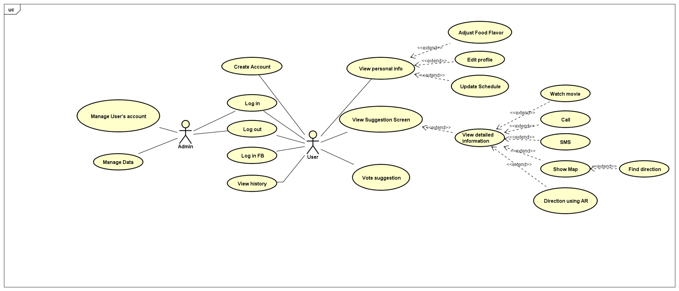
Use-case model

Slide 7
Non-functional requirements
Fast responses time: Application gives appropriate suggestions within 1 second.
Maintainable.
Good architecture so it is expandable.
Doesn’t consume much resources: Mobile device with RAM 2GB can use application smoothly.
Automatic process anytime: the server updates information of users daily for better suggestion.

Slide 8
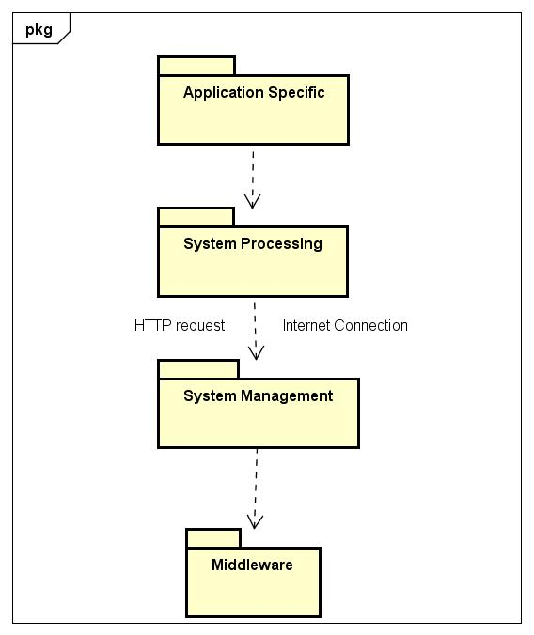
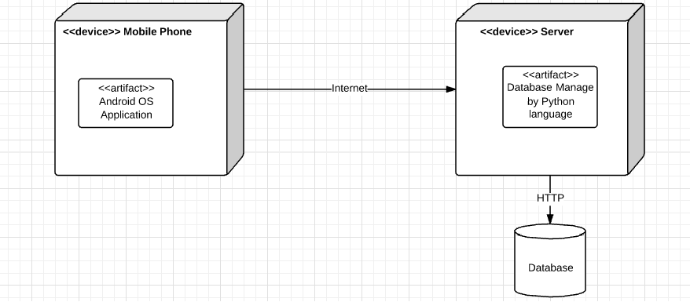
Architecture
Logical View
Deployment View

Slide 9
Test Environments
Sofware in the Test Environment
Hardware Minimum Requirements:
_Operating system: Android (minSDK = 17)
_ RAM: 1G
_ GPS Location On
_ API Level: 17
_ Android 4.2 (JELLY_BEAN_MR1)
Software Name | Purpose | Version | Type & Other Notes
Windows OS | Run the Katalon Studio | 10, 64bit | Operating System
Android OS | Run the demo application | API 19 4.4.2 Kitkat | Operating System
Android OS | Run the demo application | 5.1 Lollipop | Operating System

Slide 10
Test Plan
Target test items:
Create account.
Log in/ Log out.
View detailed suggestions.
Rate the suggestions.
View History.
Update profile.
Performance smoothly on device with 2GB RAM.

Slide 11
Test Results
Test on Register
ID | Description | Expected Result | Actual Result | Status | Is Fixed
01 | Register with full data filled | Account is created | Registered successfully | Passed | ---
02 | Real Name field is blank | Error message appears | Error message appeared | Passed | ---
03 | User Name field is blank | Error message appears | Error message appeared | Passed | ---
04 | Password field is blank | Error message appears | Error message appeared | Passed | ---
05 | Password Confirm does not match | Error message appears | Error message appeared | Passed | ---

Slide 12
Test Results
Test on Sign in
ID | Description | Expected Result | Actual Result | Status | Is Fixed
01 | Sign in with correct information. | Authenticated. | Login successfully. Welcome message. | Passed | ---
02 | Sign in with wrong information | Error message appears. | Error message appeared. | Passed | ---
03 | Sign in with a blank information | Error message appears. | Error message appeared. | Passed | ---
04 | Sign in with Facebook | Authenticated. | Login successfully. Welcome message. | Passed | ---
05 | Sign in without internet connection. | Error message appears | Nothing happened | Failed | Yes

Slide 13
Test Results
Test on Voting Suggestion
ID | Description | Expected Result | Actual Result | Status | Is Fixed
01 | Vote suggestion by swiping card on the right direction. | Action is recorded and updated to server. | Action was recorded and updated to server. | Passed | ---
02 | Vote suggestion by swiping card on the wrong direction. | Nothing happened | Card remains the same position | Passed | ---
03 | Vote suggestion by pressing buttons | Action is recorded and updated to server. | Action was recorded and updated to server. | Passed | ---
04 | Moving to others screen and back to main screen | Information on the card is the same as before moving | Card was refreshed and back to the start state | Failed | Yes

Slide 14
Test Results
Test on Detail Screen
ID | Description | Expected Result | Actual Result | Status | Is Fixed
01 | Showing information about the suggestion | Show the info of food. Show the stores selling that food. | The stores information was wrong | Failed | Yes
02 | Call / Text to the stores | The action is performed successfully | The action was performed successfully | Passed | ---
03 | Map and Direction | Map marks the right place of the store. Direction to the store is accurate. | Map marker was wrong. Direction was right | Failed | Yes
04 | Direction using Augmented Reality | Appears info of the store in the right direction | The information only appears with some well-format store’s address | Failed | No

Slide 15
Test Results
Test on History
ID | Description | Expected Result | Actual Result | Status | Is Fixed
01 | History records the liked activity | Liked activity is showed in the history list | Liked activity was showed in the history list | Passed | ---
02 | History updates rate | History list is auto updated | The list was updated but not automatically changed on screen. It need a soft refresh. | Failed | No

Slide 16
Test Results
Test on User Profile
ID | Description | Expected Result | Actual Result | Status | Is Fixed
01 | Showing information | Info is shown accurately | Info was shown accurately | Passed | ---
02 | Update food and film flavor | Updates is recorded on server | Data passed on server is overload | Failed | Yes
03 | Update schedule | Updates is recorded on server | Updates is recorded on server | Passed | ---
04 | View schedule | Schedule is shown in a week view UI | Nothing showed | Failed | No

Slide 17
Test Results
Test on Display and Performance on devices
ID | Phone Model | Android version | Result
01 | ASUS Zenfone 4.5 | 4.4.2 (Kit-kat) | Display error due to screen resolution on User Profile screen.
02 | XIAOMI Redmi Note 4 | 6.0 (Marshmallow) | Passed
03 | SONY Xperia Z | 5.1.1 (Lollipop) | Passed
04 | SONY Xperia SP | 4.3 (Jelly Bean) | Passed

Slide 18
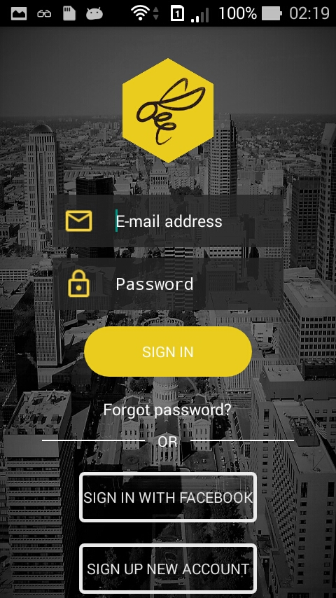
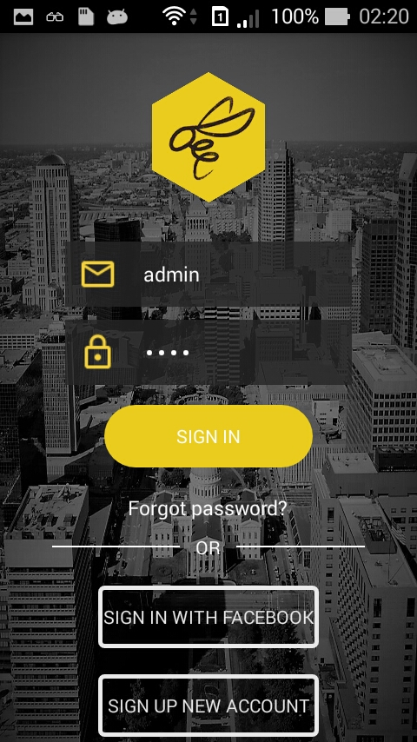
Login Screen

Slide 19
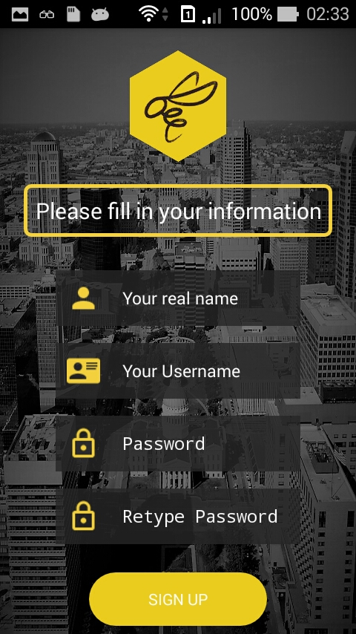
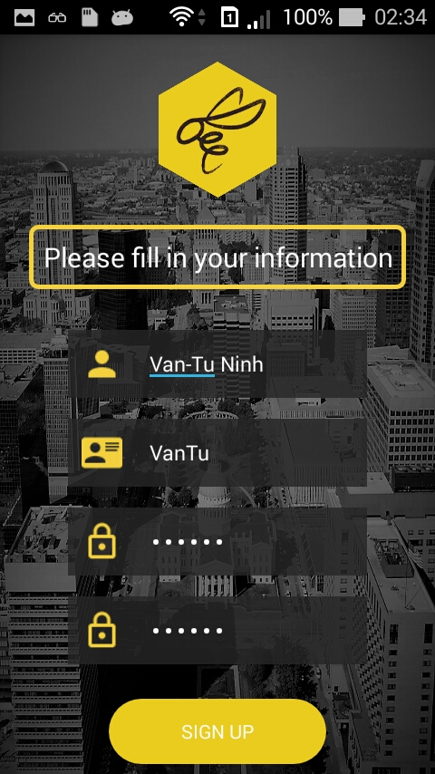
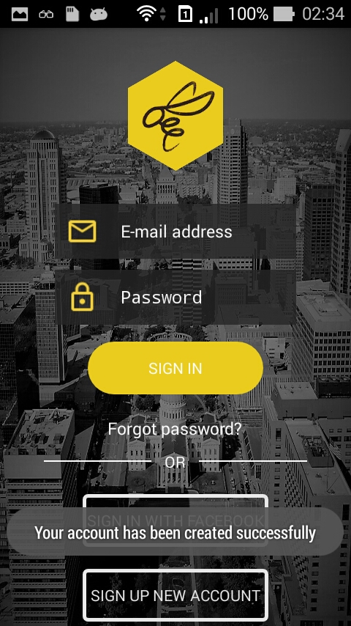
Sign Up Screen

Slide 20
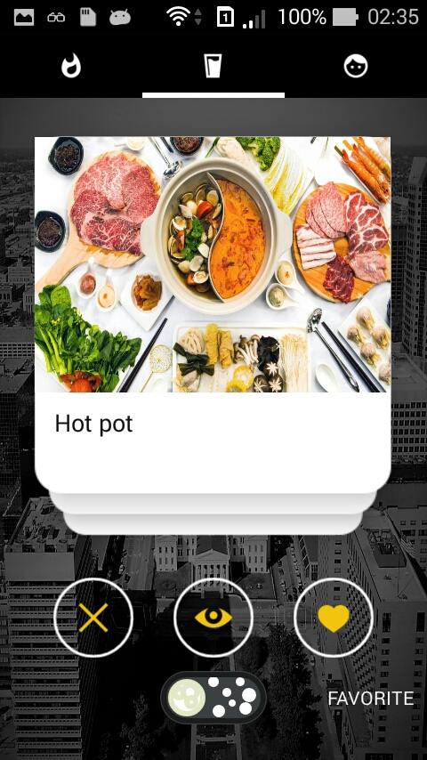
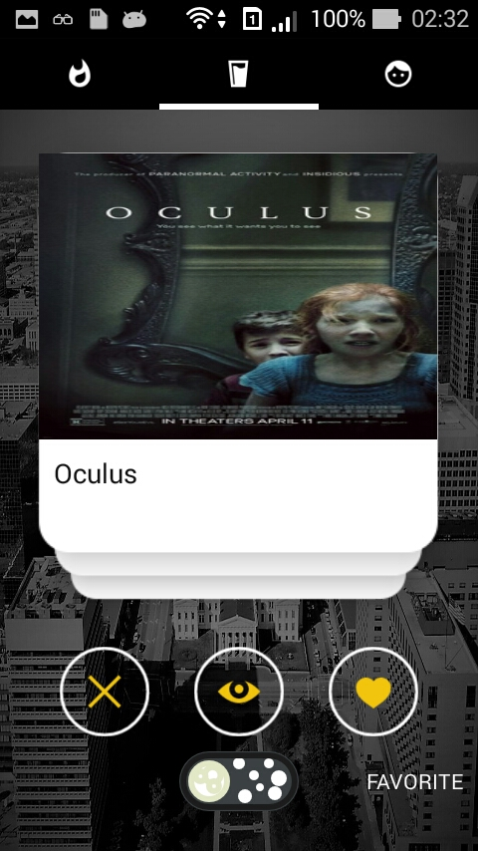
Suggest Layout

Slide 21
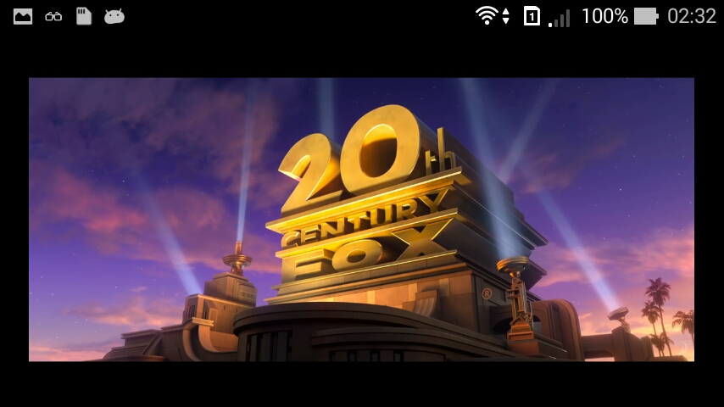
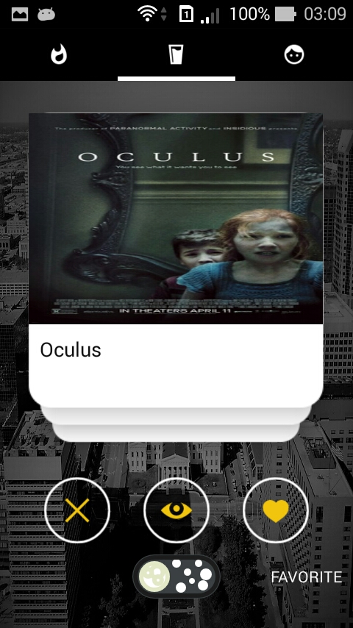
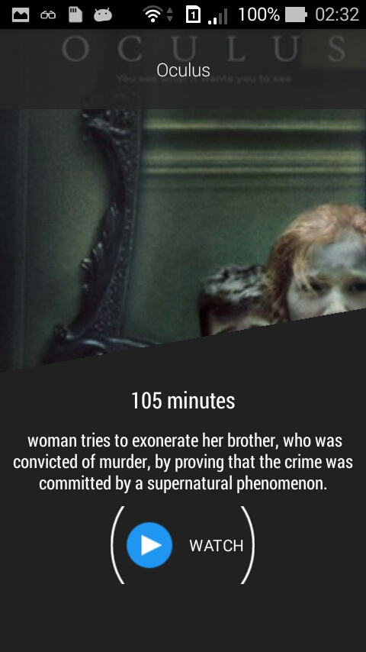
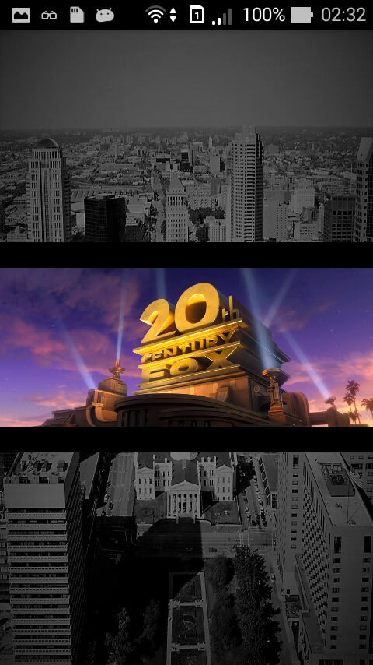
Film Detail & Watching Film

Slide 22
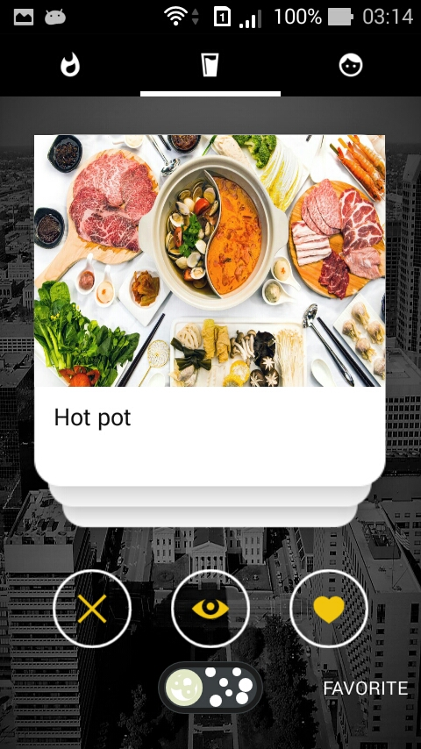
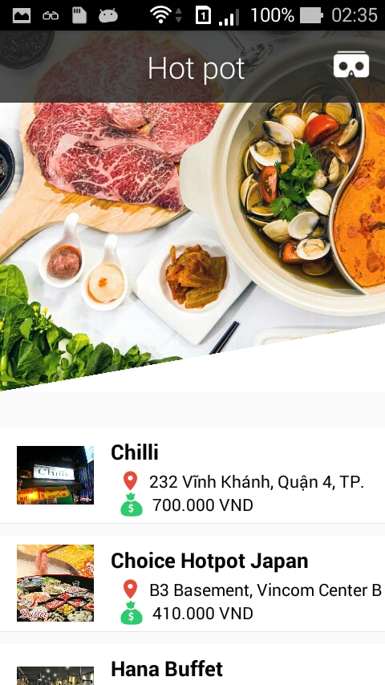
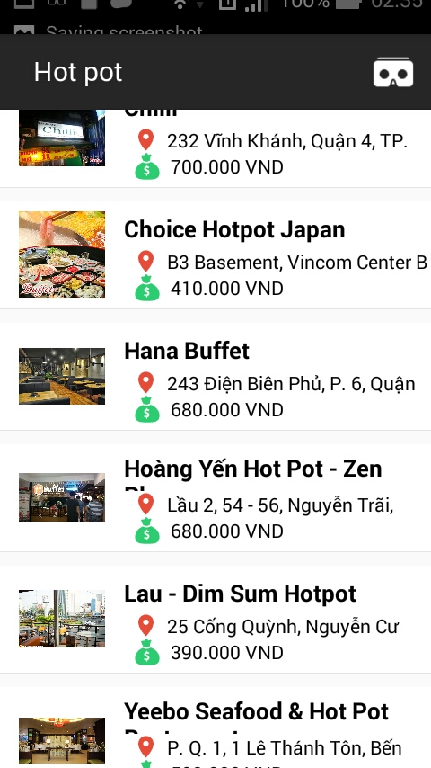
Food Detail

Slide 23
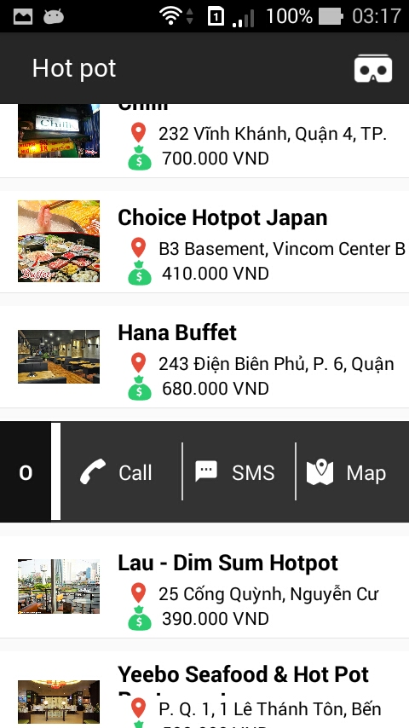
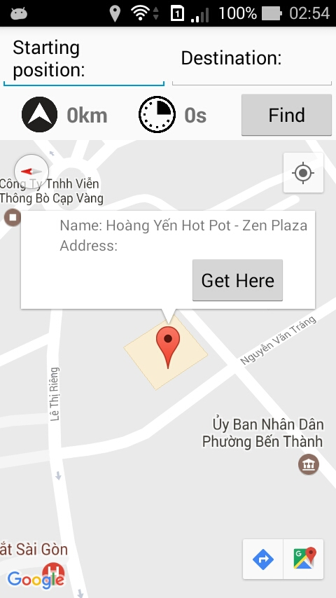
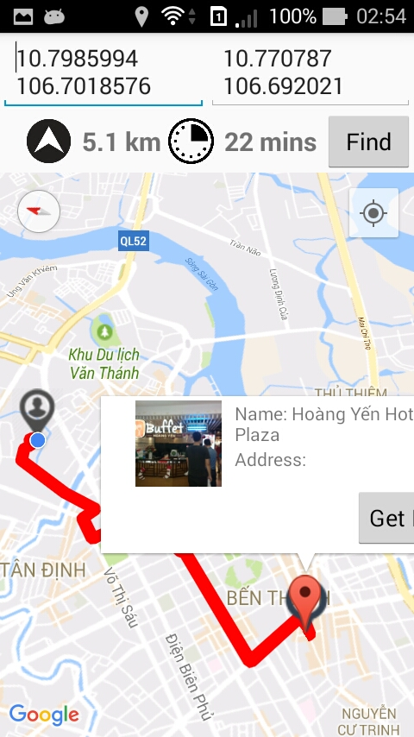
Find Direction by Google Map

Slide 24
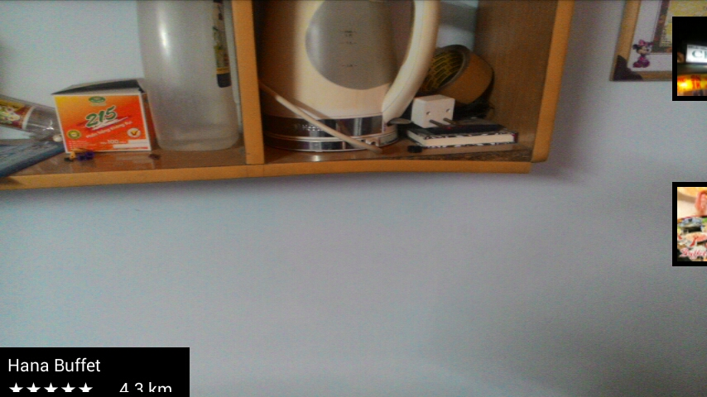
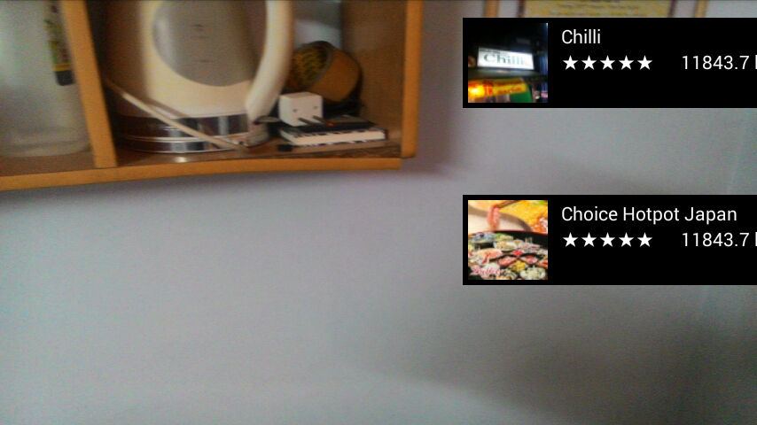
Find Direction By Using AR

Slide 25
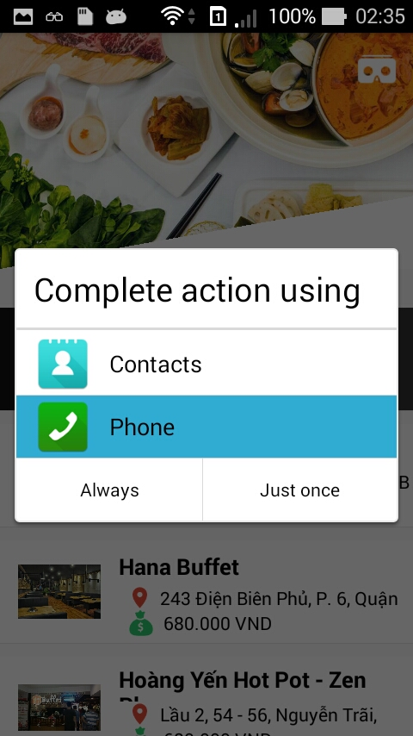
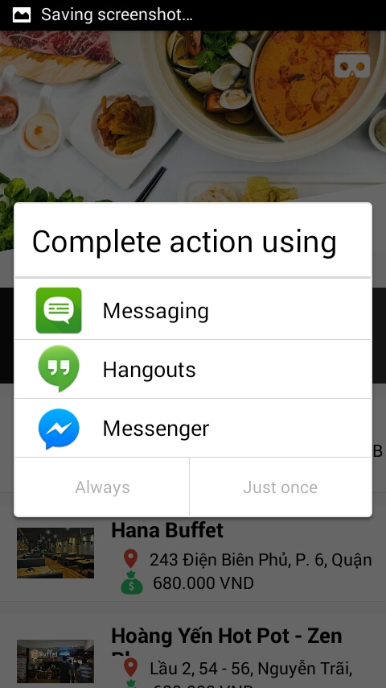
Call and Send Message Action

Slide 26
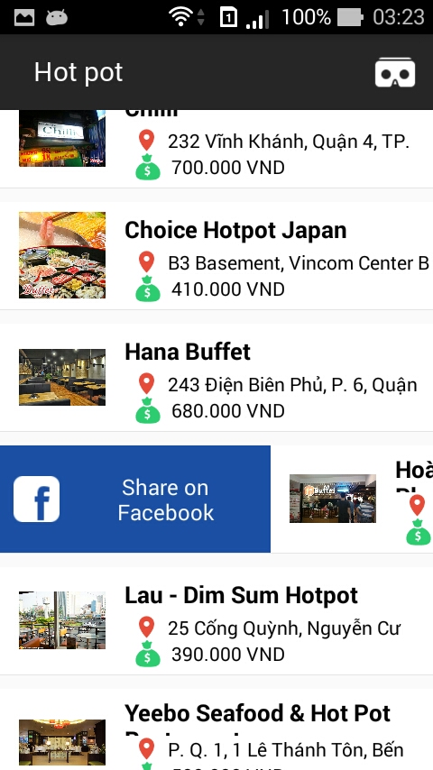
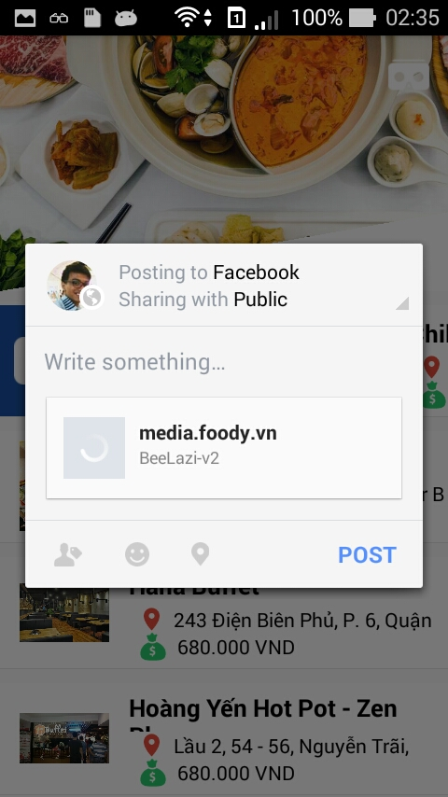
Facebook Sharing Content

Slide 27
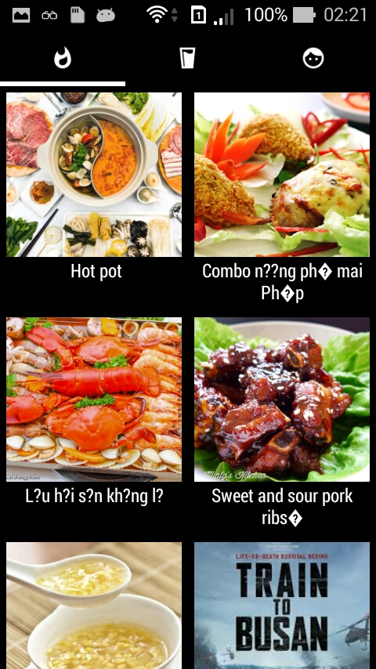
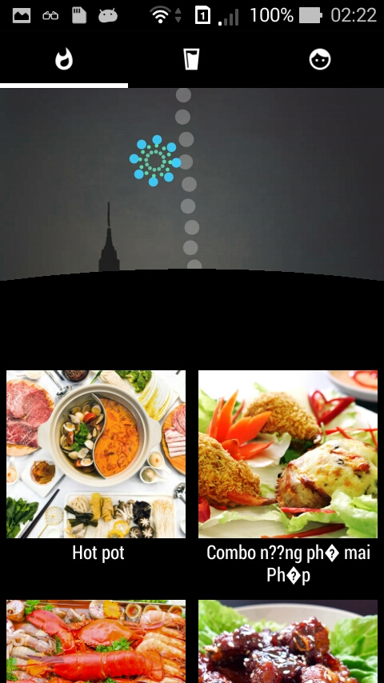
Favorite Layout

Slide 28
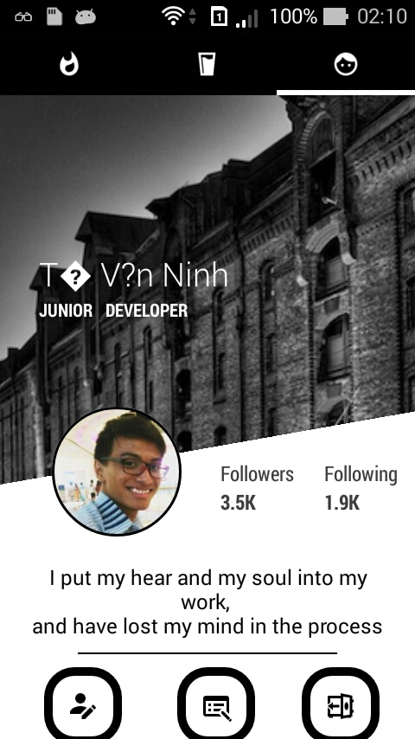
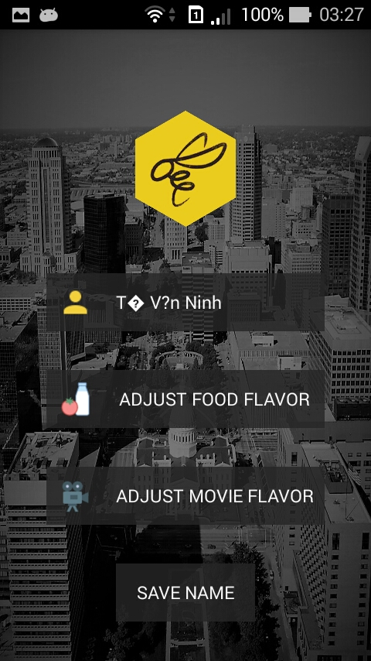
Personal Layout

Slide 29
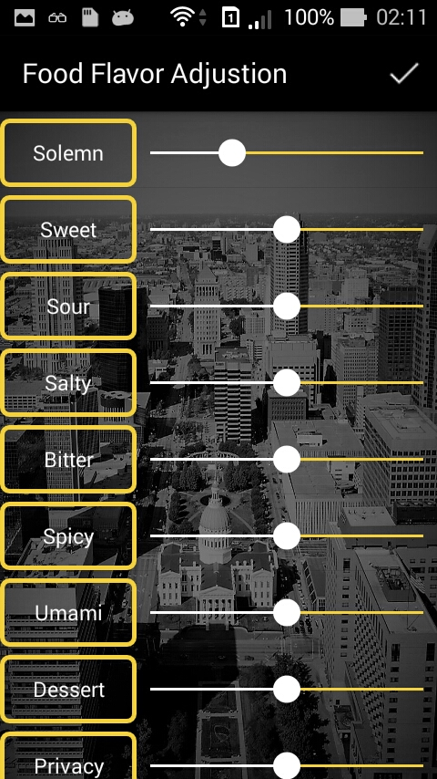
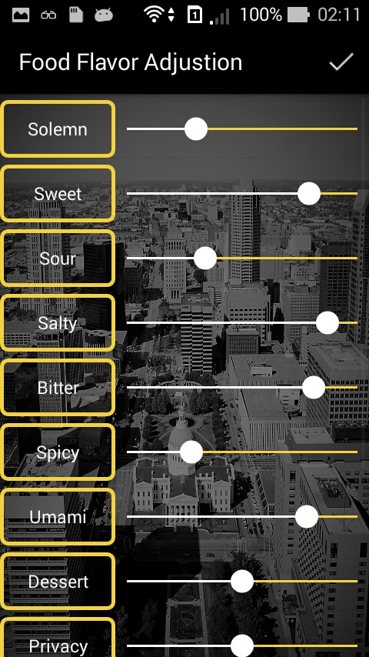
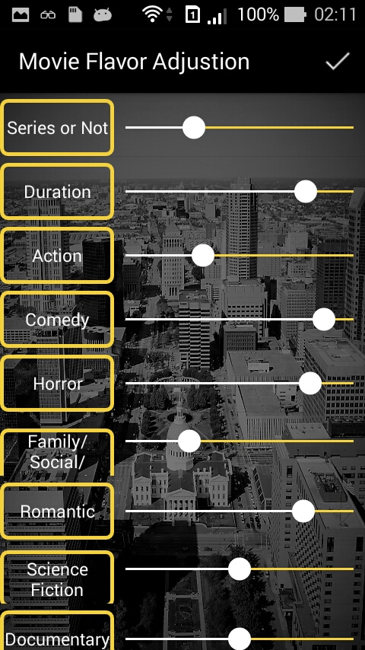
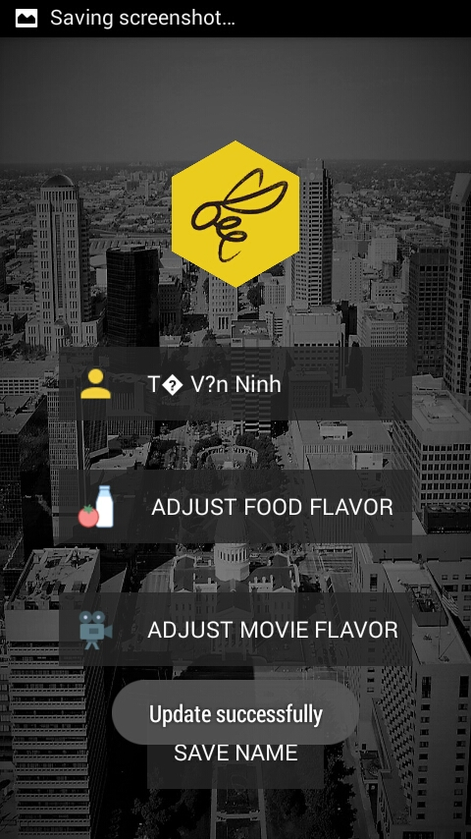
Adjust Flavor Action

Slide 30
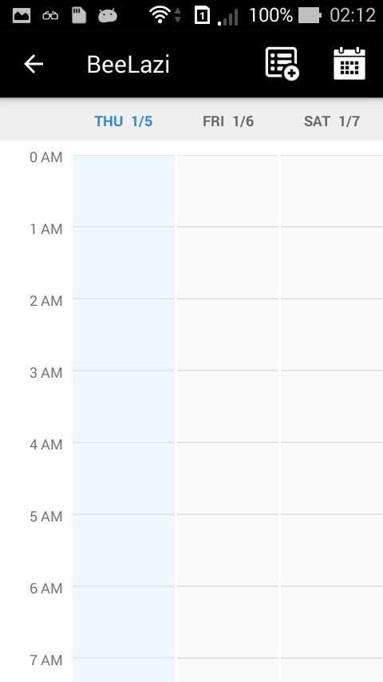
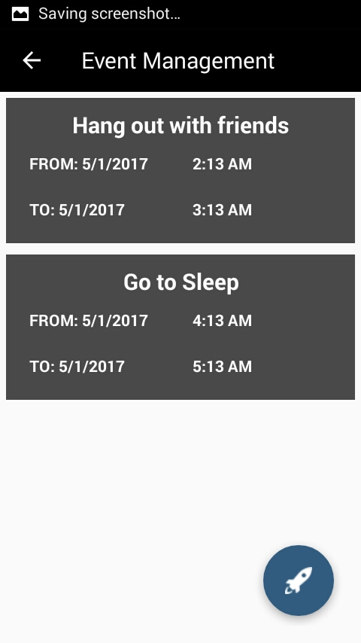
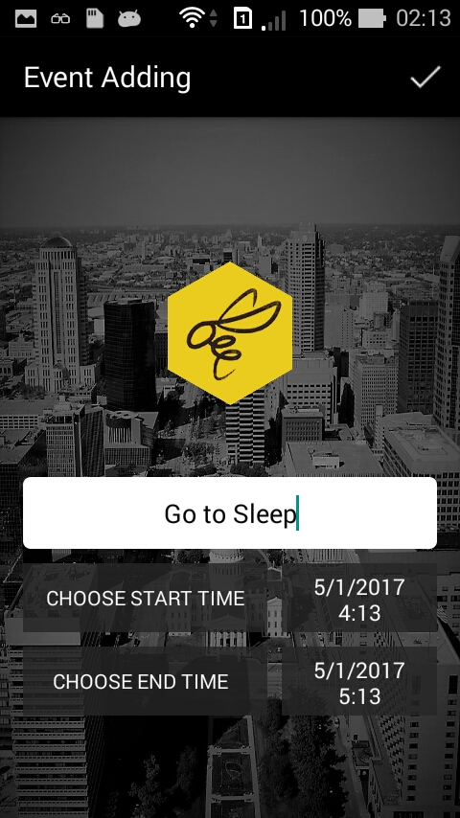
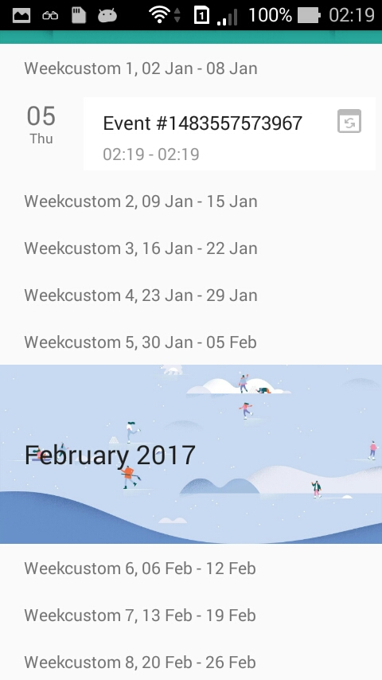
List Event Time Management

